Slide 1
DATA VISUALIZATION WITH TABLEAU
KARTHIK R

Slide 2
OVERVIEW
During my internship at Cognitive I IT Solution, I was actively involved in several tasks and projects. These activities allowed me to utilize and improve my skills in data visualization using Tableau. This experience provided me with practical insights into the importance of data-driven decision making in a professional environment. Data Visualization with Tableau: I engaged in several key tasks throughout my internship, focusing primarily on data visualization: 1. Creating interactive Dashboards: I worked on developing interactive dashboards and reports in Tableau, ensuring they were user-friendly and informative.

Slide 3
2. Data Cleaning and Transformation: I cleaned and transformed raw datasets, making them suitable for analysis and visualization by removing inconsistencies and outliers. 3. Designing Visualization: I designed data visualizations that effectively presented insights addressing key business question, ensuring clarity and relevance. 4. Collaborating with Team members: I collaborated closely with team members to understand client needs, customizing dashboards to meet specify requirements and enhance usability. 5. Client Presentations: I participated in presentations to clients showcasing the dashboards and explanation the insights derived from the data, which helped strengthen client relationships.

Slide 4
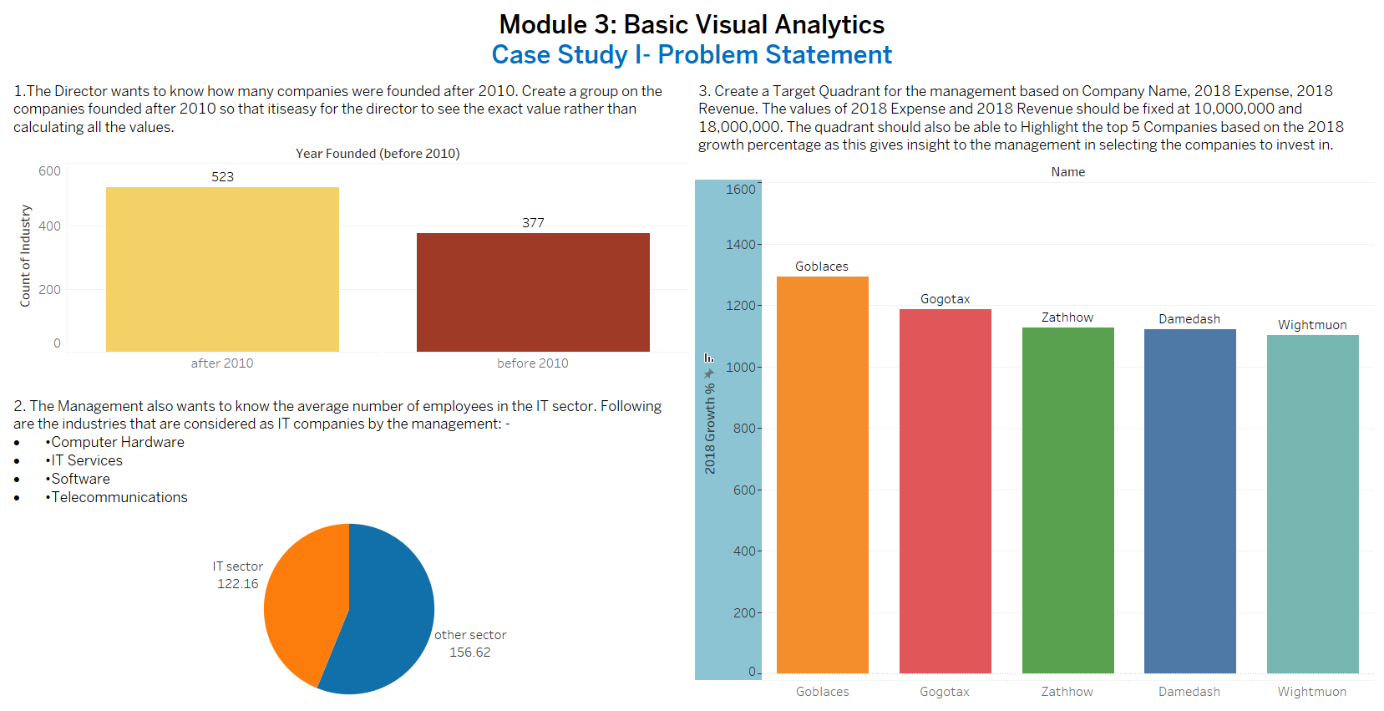

Slide 5
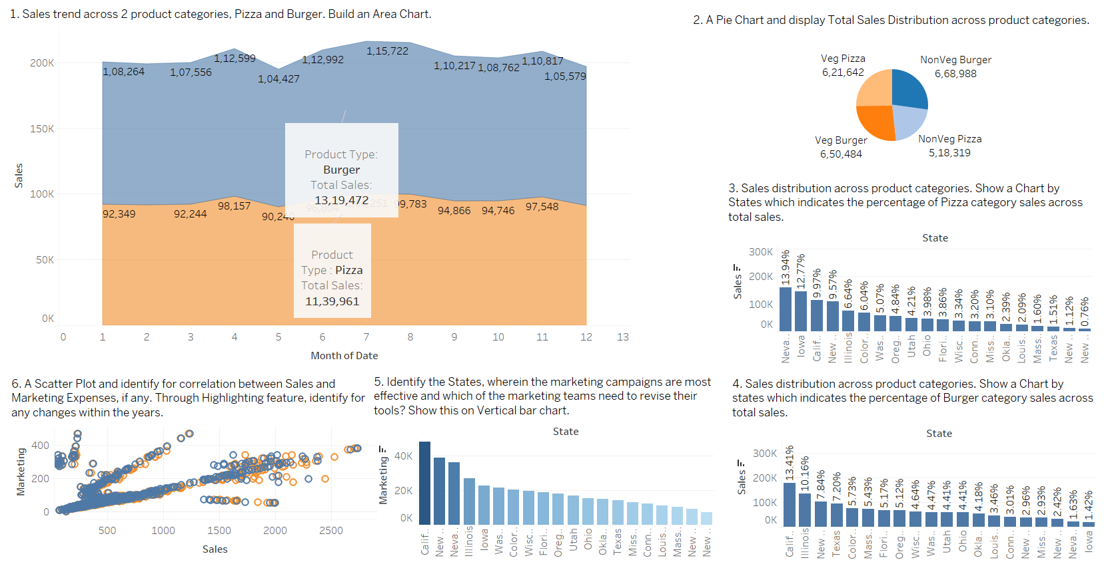

Slide 6
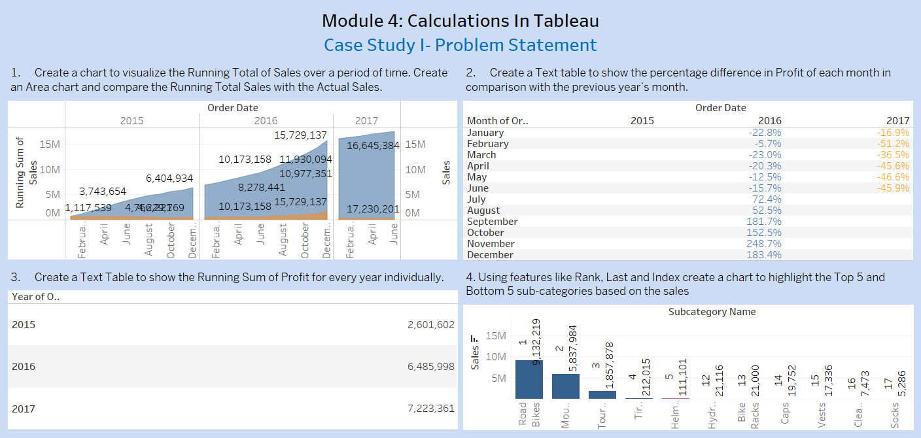

Slide 7
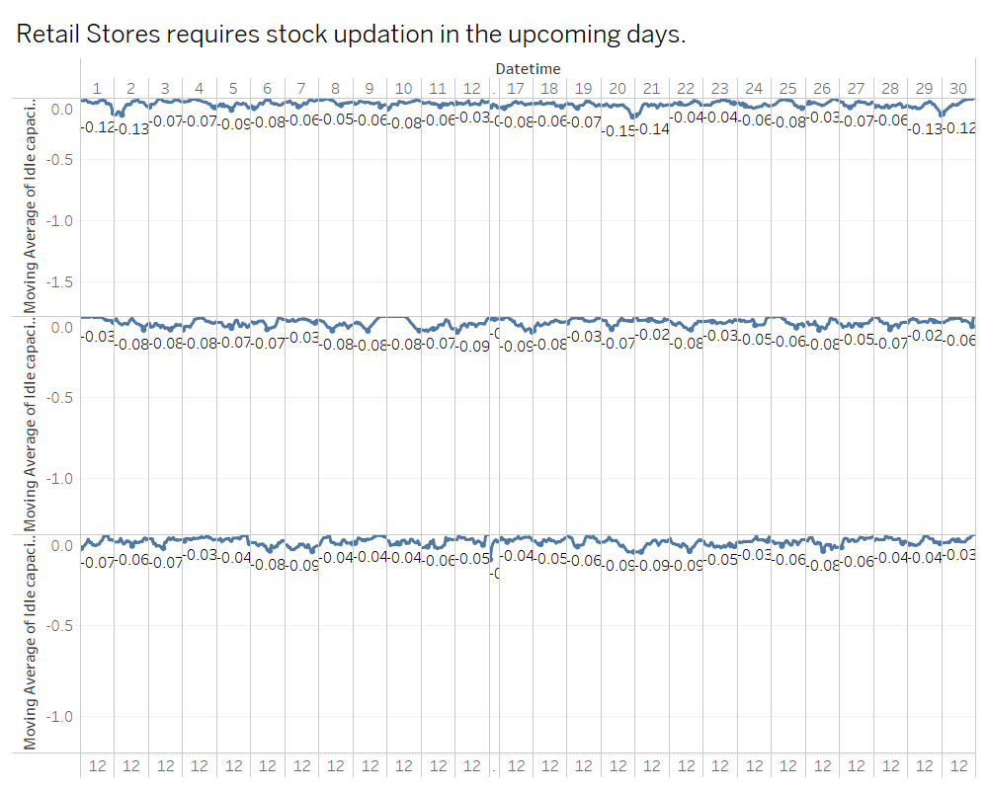

Slide 8
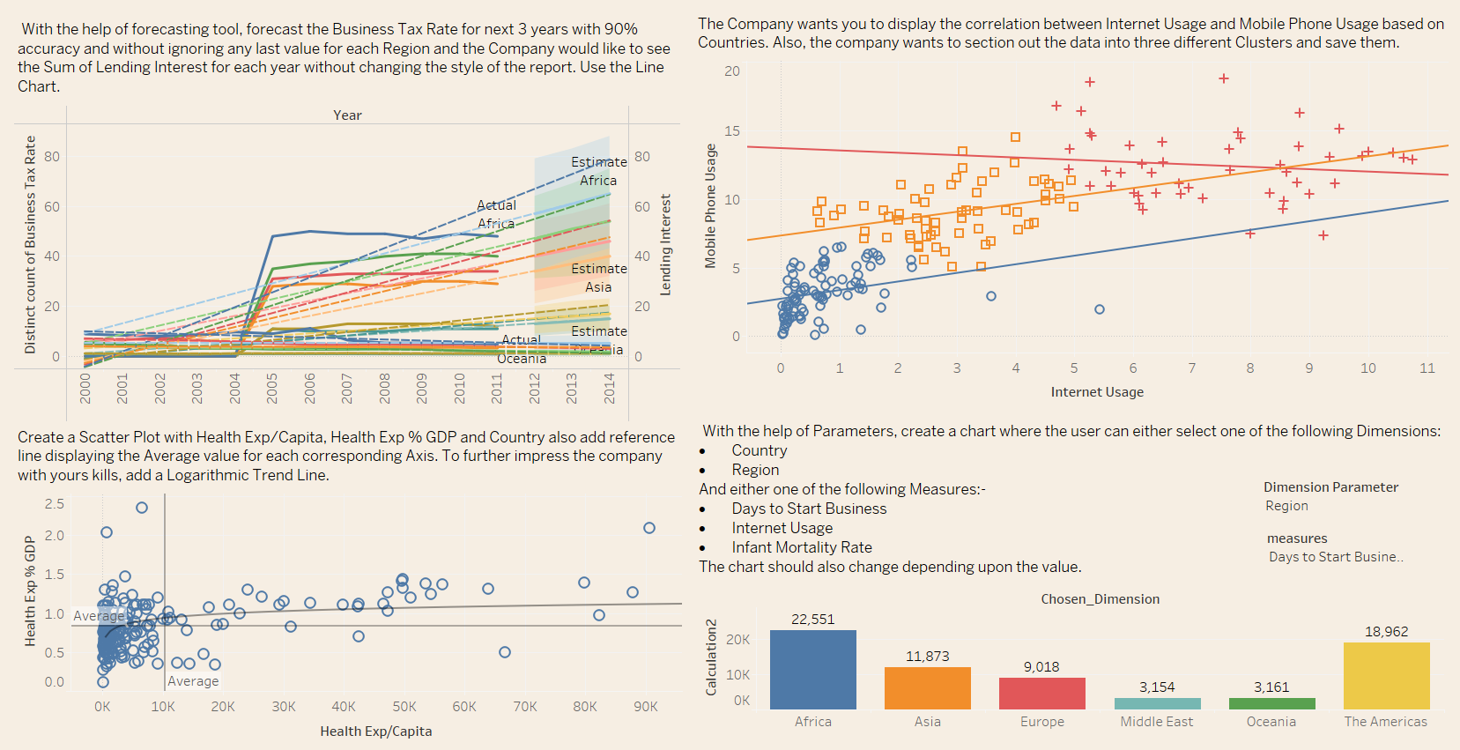

Slide 9
Conclusion: By creating these various types of charts and dashboard, we were able to learn efficient ways to use Tableau software in order to create attractive visualizations. And also, as we were allowed to present our visualization in front of others, it was positive experience presenting and interacting with others about the insights I gained while analysing the data. This internship program allowed us to work with real time data and improved our ability handle uncleaned data and using them for effective visualization. The data handling, analysing and visualizing skills learnt through this internship will allow us to set foot in a new field that has many applications such as business analytics, sports analysis, etc.,

Slide 10
THANK YOU

